Slide 1
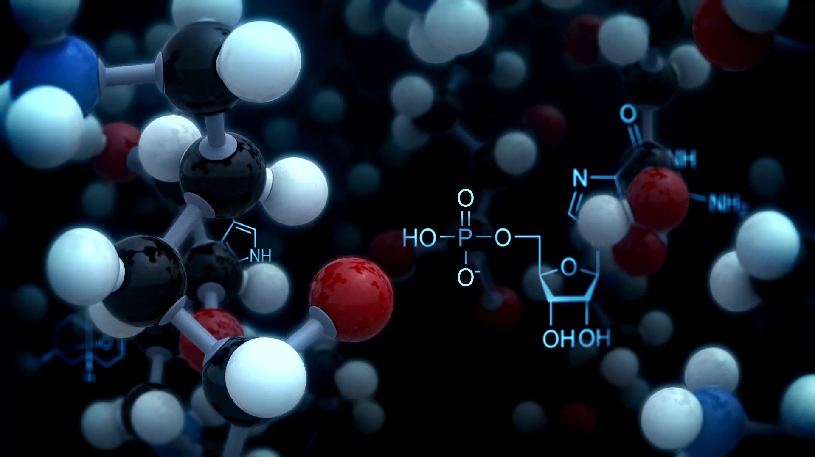
Cluster Analysis
K-Means Clustering

Slide 2

Why Clustering
Clustering can be considered as an intermediate step while analyzing larger volume of data
Clustering has quite a few important applications in data analyses such as
Detecting homogeneous segments
Outlier detection
Group characteristics identification
In many situations, predictive accuracy of a model improves when it is used within clustered data rather than applying on the entire dataset
However, when group information is not available, detecting groups is not an easy task
That is why, several clustering algorithms are proposed

Slide 3

Concept of Clustering
If there are N data points available and they are to be divided into K number of groups, the best way to do this is to put similar data points within a group and dissimilar points into other groups
There are many algorithms available to achieve this goal but partitioning algorithms are the most preferred ones
In partitioning algorithms, the entire dataset is partitioned among K groups to make sure that objects within a cluster are ‘similar’ to each other based on some objective function
In this section, we will focus on the very basic partitioning algorithm, i.e. K-Means clustering

Slide 4
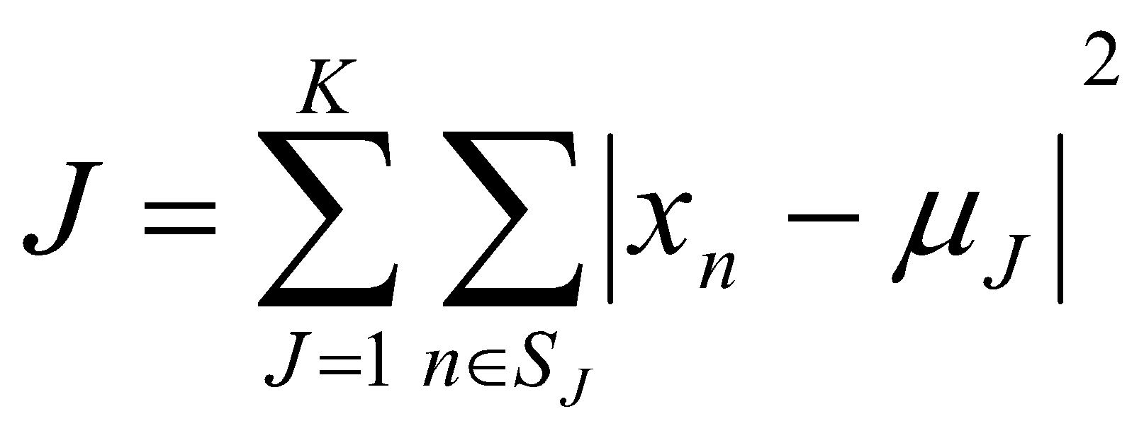
K-Means Clustering
The k-means algorithm is an algorithm to cluster n objects based on attributes into k partitions, where k < n
It assumes that the object attributes form a vector space
It is an algorithm for partitioning (or clustering) N data points into K disjoint subsets S_{j} so as to minimize the within cluster sum-of-squares value. Mathematically, within sum of square is calculated as:
where x_{n} is a vector representing the the n^{th} data point and u_{j} is the geometric centroid of the data points in S_{j}
Simply speaking k-means clustering is an algorithm to group the objects based on attributes/features into K number of group

Slide 5
K-Means Clustering Algorithm
Step 1: Begin with a decision on the value of k = number of clusters
Step 2: Put any initial partition that classifies the data into k clusters. You may assign the training samples randomly,or systematically as the following
Take the first k training sample as single- element clusters
Assign each of the remaining (N-k) training sample to the cluster with the nearest centroid. After each assignment, recompute the centroid of the gaining cluster

Slide 6
K-Means Clustering Algorithm
Step 3: Take each sample in sequence and compute its distance from the centroid of each of the clusters. If a sample is not currently in the cluster with the closest centroid, switch this sample to that cluster and update the centroid of the cluster gaining the new sample and the cluster losing the sample
Step 4 . Repeat step 3 until convergence is achieved, that is until a pass through the training sample causes no new assignments

Slide 7
K-Means Clustering Example (K=2)
Let us consider the tiny dataset given below
Individual | Variable 1 | Variable 2
1 | 1.0 | 1.0
2 | 1.5 | 2.0
3 | 3.0 | 4.0
4 | 5.0 | 7.0
5 | 3.5 | 5.0
6 | 4.5 | 5.0
7 | 3.5 | 4.5

Slide 8
K-Means Clustering Example (K=2)
Step 1: Randomly assign any two individuals as two centroids
Individual | Variable 1 | Variable 2
1 | 1.0 | 1.0
2 | 1.5 | 2.0
3 | 3.0 | 4.0
4 | 5.0 | 7.0
5 | 3.5 | 5.0
6 | 4.5 | 5.0
7 | 3.5 | 4.5
Starting Centroids (1.0,1.0) and (5.0,7.0)

Slide 9
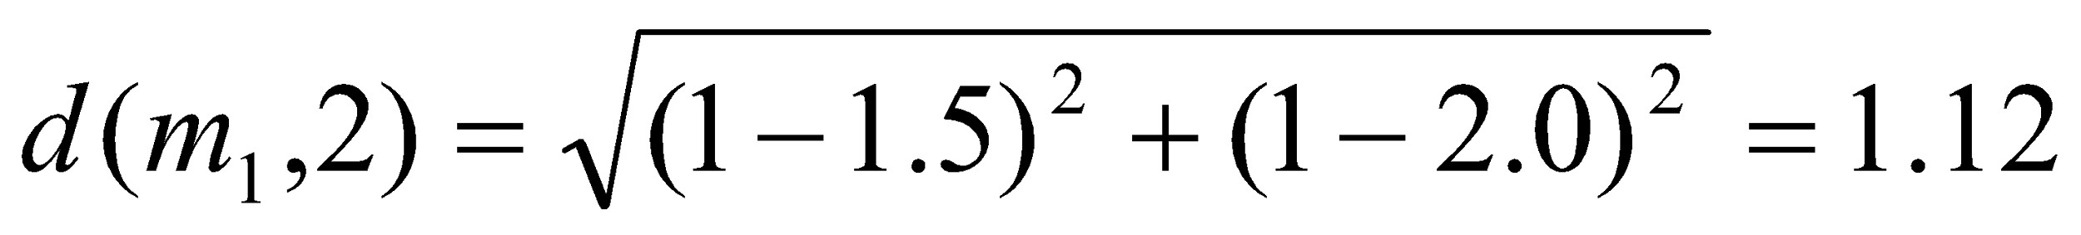
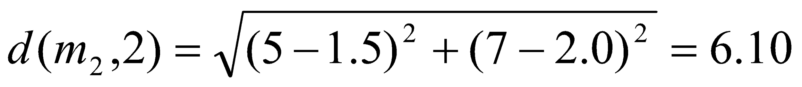
K-Means Clustering Example (K=2)
{1,2,3} forms Cluster 1 and {4,5,6,7} forms Cluster 2
Individual | Centroid 1 Dist | Centroid 2 Dist
1 | 0.0 | 7.21
2 (1.5,2.0) | 1.12 | 6.10
3 | 3.61 | 3.61
4 | 7.21 | 0.0
5 | 4.72 | 2.5
6 | 5.31 | 2.06
7 | 4.30 | 2.93
Lower Values form cluster

Slide 10
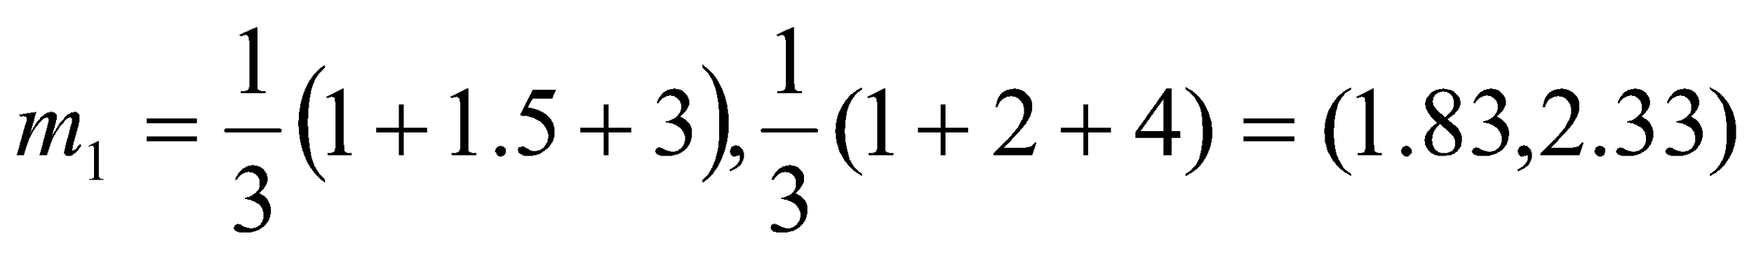
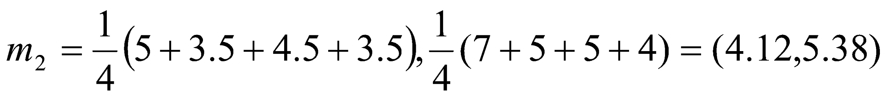
K-Means Clustering Example (K=2)
Individual 3 will move from Cluster 1 to Cluster 2
Thus {1,2} will form Cluster 1 and {3,4,5,6,7} will form Cluster 2
New Centroids are
Individual | Centroid 1 Dist | Centroid 2 Dist
1 | 1.57 | 7.21
2 (1.5,2.0) | 0.47 | 6.10
3 | 2.04 | 1.78
4 | 5.64 | 1.84
5 | 3.15 | 0.73
6 | 3.78 | 0.54
7 | 2.74 | 1.08

Slide 11
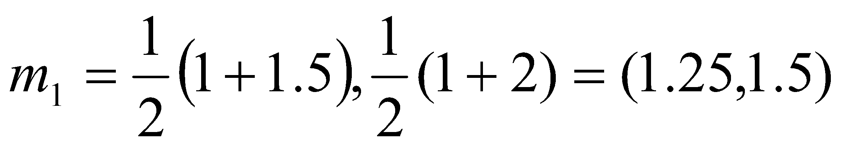
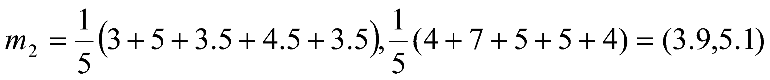
K-Means Clustering Example (K=2)
Since there is no change in cluster membership, no change in cluster centroid and hence the algorithm stops
Final clusters are {1,2} and {3,4,5,6,7}
New Centroids are
Individual | Centroid 1 Dist | Centroid 2 Dist
1 | 0.56 | 7.21
2 (1.5,2.0) | 0.56 | 6.10
3 | 3.05 | 1.42
4 | 6.66 | 2.20
5 | 4.16 | 0.42
6 | 4.78 | 0.61
7 | 3.75 | 0.72

Slide 12
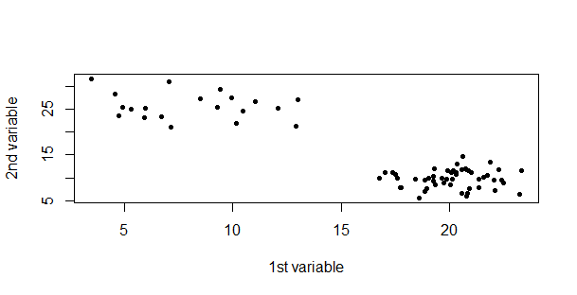
K-Means clustering with R
Let us create some data
exampleData=matrix(c(rnorm(50,20,2),rnorm(20,8,3),rnorm(50,10,2),rnorm(20,25,3)),nrow=70)
The data created in this way has 70 rows and are already segmented in two parts
The scatter plot shows
the data distribution
R Code: plot(exampleData,pch=20,xlab="1st variable",ylab="2nd variable")
Get the raw data from here: https://www.dropbox.com/s/y3qxg3nv7yqr9oq/exampleData.csv?dl=0
Make sure to remove the 1st column

Slide 13
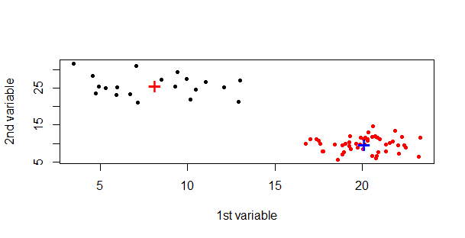
K-Means clustering with R
To run kmeans clustering in R kmeans() function is used
R codes are given below:
cluster=kmeans(exampleData,centers=2)
plot(exampleData,pch=20,xlab="1st variable",ylab="2nd variable",col=cluster$cluster)
points(cluster$centers,pch="+",col=c("red","blue"),cex=2)
Cluster centers

Slide 14
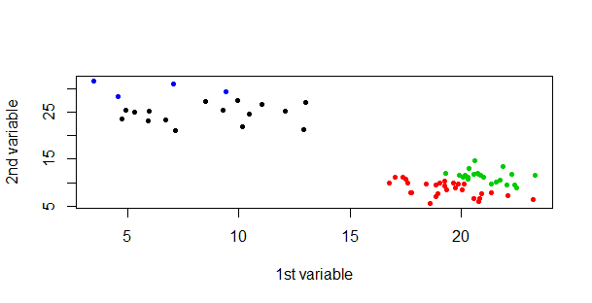
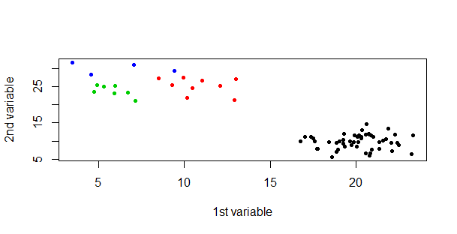
K-Means clustering with R
Until and unless the clusters are markedly distinct from each other, kmeans clustering will produce different results on each run
If number of clusters are 4 (instead of 2), in two separate runs two separate outcomes have come up (as shown below)

Slide 15
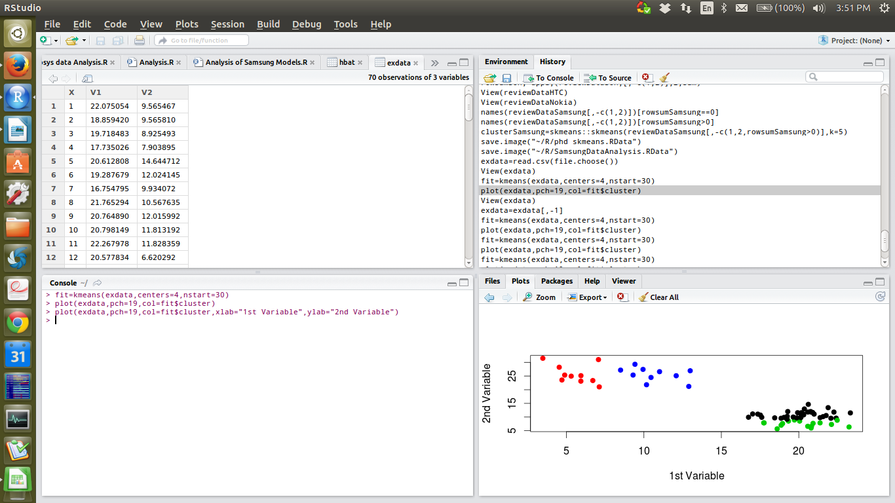
K-Means clustering with R
K-means algorithm gives different results in each run because it is a ‘greedy’ algorithm and has very high probability to get stuck into local minima since initialization starts at random
To minimize the chances of getting stuck in local minima, initialization can be started at multiple points ( multiple random start) and the best model is returned out of those many random starts
fit=kmeans(exampleData,centers=4,nstart=30)
plot(exampleData,pch=19,col=fit$cluster,xlab=”1st Variable”, ylab=”2nd Variable”)

Slide 16
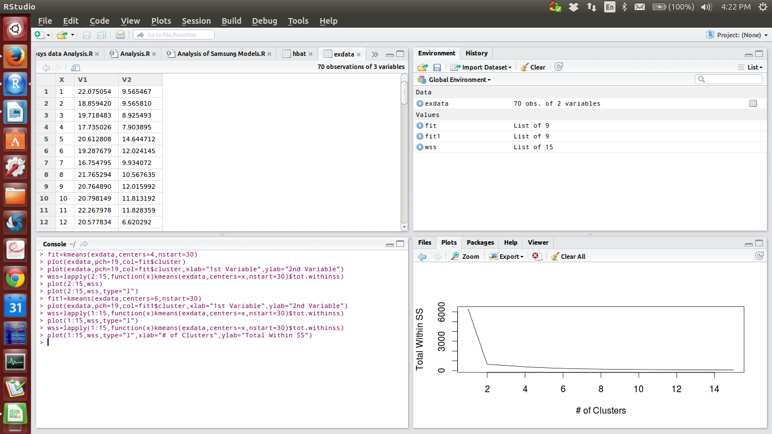
K-Means clustering with R
Deciding the optimum number of clusters is a concern in K-means clustering as the researcher has to specify the number of clusters to extract apriori
R sends out a few more information as output of k-means clustering and total within sum of square value is one of them which can be used to find out optimum number of clusters
wss=sapply(1:15,function(x)kmeans(exampledata,centers=x,nstart=30)$tot.withinss)
plot(1:15,wss,type="l",xlab="# of Clusters",ylab="Total Within SS")
Elbow formation suggests that optimum # of clusters is 2

Slide 17
K-Means clustering with R
In many cases the scree plot does not have a sharp elbow
In those cases ‘silhouette’ distance can be used for finding the optimum number of clusters
Cluster solution, which gives largest average silhouette distance would be considered as the best solution
Usually, if average silhouette distance is above 0.5, a cluster solution is considered as fair and if it crosses 0.7, cluster solution would be considered as good

Slide 18
K-Means clustering with R
R Code to extract average silhoutte distance
find_silhouette=function(data,cluster){
require(cluster)
fit=kmeans(scale(data),centers = cluster,nstart=100)
s=silhouette(x = fit$cluster,dist(scale(data)))
mean(s[,3])
}
sapply(2:20,find_silhouette,data=exampleData)

Slide 19
Issues and advantages
Advantages
Very simple algorithm
Always converges (even though locally)
Quite fast and interpretation of clusters is quite easy
Issues
Greatly affected by extreme values
Performs poorly for irregular shaped data points (longitude and latitude)
Each time it is run, different results may come out!
Cannot handle categorical data

